Slide 1
Hipertensión Portal / Cirrosis

Slide 2


Best of The Liver Meeting® 2019 Slides in Spanish
Contenido original de The Liver Meeting® 2019 de AASLD. Traducción proporcionada por la Asociación Mexicana de Hepatología.
https://hepatologia.org.mx/
Traducciones por el Dr. Ignacio Aiza Haddad, Dr. Oscar Morales Morales Gutiérrez y Dr. Rene Male

Slide 3
Acerca del programa:
Lo Mejor del Liver Meeting 2019 fue creado por el Comité del Programa Científico en beneficio de los miembros de AASLD, los asistentes a la conferencia anual y otros médicos involucrados en el tratamiento de enfermedades hepáticas. El programa está destinado a resaltar algunas de las presentaciones orales y posters clave de la reunión y proporcionar puntos de vista de los propios autores sobre implicaciones para la atención del paciente e investigación en curso.
Scientific Program Committee
Chair | Michael W. Fried, MD, FAASLD
Co-Chair | Meena B. Bansal, MD, FAASLD
President-Elect | Jorge A. Bezerra, MD, FAASLD
Senior Councilor | Raymond T. Chung, MD, FAASLD
Annual Meeting Education Committee | Grace L. Su, MD, FAASLD
Basic Research Committee | Harmeet Malhi, MD, MBBS, FAASLD
Clinical Research Committee | Kymberly Watt, MD
CME Committee | Alex Befeler, MD
Hepatology Associates Committee | Patrick M. Horne, MSN, ARNP, FNP-BC
Surgery and Liver Transplantation Committee | John C. Magee, MD
Training and Workforce Committee | K. Gautham Reddy, MD, FAASLD
Acerca del programa:
Todo el contenido encontrado en este conjunto
de diapositivas es propiedad de la Asociación
Americana para el Estudio de Enfermedades
del Hígado (AASLD), sus proveedores de contenido o sus licenciatarios según sea el caso, y está protegido por derechos de autor, marca registrada y otros derechos de autor estadounidenses e internacionales. La AASLD otorga licencias personales, limitadas, revocables, no transferibles y no exclusivas para acceder y leer contenido en esta presentación de diapositivas solo para uso personal, no comercial y sin fines de lucro. La plataforma deslizante está disponible solo para uso legal y personal y no para uso comercial. No se permite la reproducción y / o distribución no autorizadas de este trabajo protegido por derechos de autor.

Slide 4
CONFIRM: Estudio Norte Americano aleatorizado controlado de terlipresina más albúmina para tratamiento de SHR-1
Objetivo:
Confirmar la eficacia y seguridad de terlipresina + albumina vs albúmina sola en pacientes con SHR-1 (basado en criterio ICA*)
Métodos:
Ensayo doble ciego, prospectivo con 300 pacientes aleatorizados 2:1 para terlipresina (1 mg IV c6 hrs) o placebo (con albúmina en ambos grupos).
Desenlace primario: RVSHR† definida como 2 valores de CrS consecutivos ≤1.5 mg/dL con ≥2h separación, al día 14 o al egreso; los sujetos deben estar vivos sin TSR por ≥10 días después de lograr RVSHR
Resultados:
Mejoría significativa en función renal observada con terlipresina.
La incidencia de TSR post-trasplante hepático fue 19.6% con terlipresina con albúmina vs 44.8% con albúmina sola (P=0.036).
Conclusiones:
La terlipresina es efectiva para mejorar la función renal y lograr reversión del SHR en pacientes con SHR-1 y enfermedad hepática avanzada progresiva.
Outcome, n (%) | Terlipressin n=199 | Placebo n=101 | P Value
Primary endpoint: VHRSR† | 58 (29.1) | 16 (15.8) | 0.012
HRSR‡ | 72 (36.2) | 17 (16.8) | <0.001
Durability of HRSR (no RRT to Day 30) | 63 (31.7) | 16 (15.8) | 0.003
HRSR in the SIRS subgroup | 28 (33.3) | 3 (6.3) | <0.001
VHRSR with no recurrence of HRS by Day 30 | 48 (24.1) | 16 (15.8) | 0.092
Alive and Transplant-free at Day 90, % (n) | 26.1 (52) | 26.7 (27) | 0.78
* ICA Club Internacional de la Ascitis
†RVSHR, Reversión verificada del síndrome hepatorenal.
‡RSHR, Reversión del síndrome hepatorenal (disminución en la CrS ≤1.5 mg/dL).
TSR, Terapia sustitutiva renal; CrS, creatinina sérica; SRIS, síndrome de respuesta inflamatoria sistémica.
Wong F, et al., Abstract LO5
Notes:
LO5
THE CONFIRM STUDY: A NORTH AMERICAN RANDOMIZED CONTROLLED TRIAL (RCT) OF TERLIPRESSIN PLUS ALBUMIN FOR THE TREATMENT OF HEPATORENAL SYNDROME TYPE 1 (HRS-1)
Florence Wong, Medicine, University of Toronto, Michael P. Curry, Medicine, Beth Israel Deaconess Medical Center, Boston, MA, K Rajender Reddy, University of Pennsylvania, Philadelphia, PA, USA, Raymond A. Rubin, Piedmont Healthcare, Michael K. Porayko, Medicine, Vanderbilt University Medical Center, Nashville, TN, Stevan A. Gonzalez, Medicine, Baylor Scott & White All Saints Medical Center, Fort Worth, TX, Khalid Mumtaz, Ohio State University, Nicholas Lim, Medicine, University of Minnesota, Minneapolis, MN, Douglas A. Simonetto, Medicine, Mayo Clinic, Rochester, MN, Pratima Sharma, Medicine, University of Michigan Medical Center, Ann Arbor, MI, Arun Sanyal, Medicine, Virginia Commonwealth University, Richmond, VA, Marlyn J. Mayo, Medicine, UT Southwestern Medical Center, Dallas, TX, Richard Todd Frederick, Hepatology and Liver Transplantation, California Pacific Medical Center, Stephen Chris Pappas, Orphan Therapeutics LLC, Annandale, NJ, Khurram Jamil, Mallinckrodt Pharmaceuticals, Bedminster, NJ and the CONFIRM Study Investigators
Background:
HRS-1 is a serious, potentially reversible form of acute kidney injury (AKI) in patients with cirrhosis and ascites. The aim of the CONFIRM study was to confirm the efficacy and safety of terlipressin plus albumin versus albumin alone for the treatment of HRS-1 in patients with well-defined HRS-1.
Methods:
HRS-1 was defined based on modified prior criteria outlined by the International Club of Ascites (ICA), as rapidly deteriorating renal function to SCr ≥2.25 mg/dL, with actual or projected doubling of SCr within 2 weeks, without improvement in renal function (<20% decrease in SCr 48 hours after both diuretic withdrawal and albumin-fluid challenge) in adult patients with cirrhosis and ascites. Subjects were randomized 2:1 to terlipressin (1 mg IV every 6 hours) or placebo, plus albumin in both groups. Treatment was continued to Day 14 unless the following occurred: verified HRS reversal (VHRSR), renal replacement therapy (RRT), liver transplantation (LT) or SCr at or above baseline (BL) at Day 4. VHRSR, the primary endpoint, was defined as 2 consecutive SCr values ≤1.5 mg/dL, at least 2 hours apart, with subjects alive without RRT for at least 10 days after the second SCr ≤1.5 mg/dL; HRS reversal (HRSR) was a decrease in SCr to ≤1.5 mg/dL.
Results:
(Table): 300 subjects were enrolled; 199 randomized to terlipressin, 101 to placebo. Demographic and BL clinical characteristics were similar between treatment groups. 132/300 (44%) of subjects met systemic inflammatory response syndrome (SIRS) criteria. The proportion of patients in each group who underwent LT was 23.1% for terlipressin and 28.7% for placebo. Overall adverse events (AEs) were similar for the 2 groups; serious AEs were reported in 130/200 (65%) subjects in the terlipressin group vs 60/99 (60.6%) subjects in the placebo group. Ischemia-associated AEs occurred in 4.5% of the terlipressin group vs 0% in the placebo group; no new or unexpected AEs were reported.
Conclusion:
Applying strict criteria defining HRS-1, CONFIRM demonstrates a significant reversal of worsening renal function in cirrhotic patients treated with terlipressin plus albumin when compared to those treated with albumin alone, including patients with SIRS criteria. This response was durable and associated with less need for early RRT. Terlipressin is effective in improving renal function and achieving HRS reversal in patients with HRS-1 and progressive advanced liver disease.
Disclosures:
Florence Wong – Mallinckrodt: Consulting; Mallinckrodt: Grant/Research Support; Ferring: Consulting; Sequana: Grant/Research Support; Sequana: Consulting;
Michael P. Curry – Affimune: Grant/Research Support; Salix: Grant/Research Support; Conatus: Grant/Research Support; Mallinckrodt: Grant/Research Support; Gilead Sciences: Grant/Research Support; Trio Health: Consulting; Gilead Sciences: Consulting;
Raymond A. Rubin – Intercept: Advisory Committee or Review Panel; Mallinckrodt: Advisory Committee or Review Panel; Mallinckrodt: Grant/Research Support; Intercept: Grant/Research Support; Allergan: Grant/Research Support; Novo Nordisk: Grant/Research Support; Gilead: Grant/Research Support;
Stevan A. Gonzalez – Salix: Speaking and Teaching; AbbVie: Speaking and Teaching;
Arun Sanyal – Sanyal Bio: Stock Shareholder; Exhalenz Stock, Akarna, Genfit, Durect, Indalo, Tiziana: Stock Shareholder; Novartis, Merck, Galectin, Bristol Myers, Merck, Sequana, Boehringer Ingelhiem, Echosense, Salix, Malinckrodt, Cumberland, Gilead: Grant/Research Support; Conatus, Gilead, Elsevier, Echosens, Malinckrodt, Immuron, Intercept, Pfizer, Salix, Uptodate, Boehringer Ingelhiem, Novartis, Nimbus, Nitto Denko, Hemoshear, Lilly, Novo Nordisk, Fractyl, Allergan, Chemomab, Affimmune, Teva, Ardelyx, Terns: Consulting; ENYO, Birdrock, Albireo, Sanofi, Jannsen, Takeda, Zydus, BASF, Amra, Perspectum, OWL, Poxel, Servier, Second Genome, General Electric, 89Bio: Consulting; NorthSea Therapeutics: Consulting; Albireo: Consulting; NGM Bio: Consulting; Cirius: Consulting; Astra Zeneca: Consulting;
Marlyn J. Mayo – Cymabay: Grant/Research Support; Target: Grant/Research Support; Cara: Advisory Committee or Review Panel; Salix: Grant/Research Support; Mallinckrodt: Grant/Research Support; GSK: Grant/Research Support; Intercept: Grant/Research Support;
Richard Todd Frederick – Mallinckrodt: Advisory Committee or Review Panel; Mallinckrodt: Grant/Research Support; Intercept: Speaking and Teaching; Gilead: Consulting; Morphocell: Advisory Committee or Review Panel; Salix: Advisory Committee or Review Panel; Conatus: Grant/Research Support;
Stephen Chris Pappas – Orphan Therapeutics LLC: Consulting; Mallinckrodt Pharmaceuticals: Consulting; Durect Pharmaceuticals: Consulting;
Khurram Jamil – Mallinckrodt Pharmaceuticals: Employment;
The following people have nothing to disclose: K Rajender Reddy, Michael K. Porayko, Khalid Mumtaz, Nicholas Lim, Douglas A. Simonetto, Pratima Sharma

Slide 5
Cistatina C predice la necesidad de hemodiálisis, TSH, y sobrevida libre de trasplante en candidatos a trasplante hepático
Antecedentes/Objetivos:
La creatinina sérica puede sobreestimar la TFG en
cirrosis descompensada, llevando a disparidades en la
valoración de la función renal. La cisatina c sérica puede
reflejar con mayor exactitud la función renal y predecir
desenlaces clínicos
Métodos:
Dos-centros, prospectivo, estudio de cohorte de
candidatos a trasplante hepático (n=246). La Cistatina
c sérica fue obtenida al momento de la evaluación del
trasplante.
Hallazgos principales:
El incremento de cistatina C está asociado con menor sobrevida libre de trasplante, incluyendo análisis restringido a mujeres..*
Conclusiones:
Cistatina C predice la necesidad de hemodiálisis, TSH y sobrevida libre de trasplante, y puede disminuir disparidad entre géneros.
Overall, n=246
Quartiles Cystatin C (p=0.004)
Women, n=88
Cystatin C <1.5 vs ≥1.5 mg/L (p=0.04)
Shankar N, et al., Abstract 10
*Análisis de sobrevida por cuartiles y múltiples umbrales en mujeres, p=NS. TSH, Trasplante simultáneo hígado-riñón.,
Notes:
10
CYSTATIN C PREDICTS NEED FOR HEMODIALYSIS, SLK, AND TRANSPLANT-FREE SURVIVAL IN LIVER TRANSPLANT CANDIDATES
Dr. Nagasri Shankar¹, Dr. Andres Duarte-Rojo², Dr. Mauricio Garcia Saenz de Sicilia³, Dr. Sumeet K Asrani, MD, MSc⁴, Dr. Goran Klintmalm⁴, Dr. James F. Trotter⁴, Dr. Bernard V Fischbach⁴ and Dr. Stevan A. Gonzalez⁴, (1)Internal Medicine, Baylor Scott & White University Medical Center, (2)University of Pittsburgh, (3)University of Arkansas for Medical Sciences, (4)Baylor Simmons Transplant Institute
Background:
Renal insufficiency is a common complication of end-stage liver disease and is independently associated with decreased survival. Serum creatinine is a poor surrogate measure of glomerular filtration rate in patients with cirrhosis. Serum Cystatin C (CysC) could more accurately assess renal function in liver transplant (LT) candidates and may predict outcomes including need for simultaneous liver/kidney transplant (SLK) and mortality.
Methods:
Two-center prospective cohort study of LT candidates with CysC obtained at the time of LT evaluation. Patients prospectively followed to obtain data on clinical events before and after LT, including need for hemodialysis (HD) or SLK and transplant-free survival. Receiver operator characteristic (ROC), Kaplan-Meier log-rank test, and stepwise Cox proportional hazards analyses performed.
Results:
Of 246 patients prospectively enrolled, 161 (66%) underwent LT after a median 6.6 months follow up (range 3 days to 7 years) and 40 (16%) died without LT. Characteristics included 64% male, 79% white, 71% ascites, median MELD 14 (6-40). Cause of cirrhosis: 36% hepatitis C, 21% alcohol, 20% fatty liver/cryptogenic. Incorporating CysC into MELD (MELD-CysC) accurately predicted 1-year mortality in non-transplanted patients (ROC AUC 0.81; 95% CI 0.70, 0.92) vs MELD (ROC AUC 0.78; 0.66, 0.90). Increased CysC was associated with need for pre-LT HD (p<0.001; ROC AUC 0.77; 0.65, 0.90) and SLK (p<0.001; ROC AUC 0.89; 0.77, 1.00). CysC ≥1.5 and MELD-CysC ≥15 predicted transplant-free survival, independent of age, race, encephalopathy, and gender (p=0.03 and p<0.001, respectively). Across the range of quartiles, progressive increases in CysC were associated with decreased transplant-free survival (p=0.004) but this trend was not observed in quartiles of serum creatinine (p=0.08; Figure). In analysis restricted to women (n=88), CysC ≥1.5 was predictive of transplant-free survival (p=0.04), yet creatinine was not predictive of survival at multiple thresholds (p=NS).
Conclusion:
CysC accurately predicts clinical outcomes in LT candidates including pre-LT HD, SLK, and transplant-free survival. CysC may more accurately define a full range of renal dysfunction and risk stratify patients with cirrhosis compared with serum creatinine. CysC is an independent predictor of transplant free survival especially among women and may decrease disparities by gender and disadvantage women less than creatinine-based assessment.
Disclosures:
Andres Duarte-Rojo – Axcella: Advisory Committee or Review Panel; Echosens: Grant/Research Support
Goran Klintmalm – Veloxis: Advisory Committee or Review Panel
James F. Trotter – Organox: Consulting
Stevan A. Gonzalez – Salix: Speaking and Teaching; AbbVie: Speaking and Teaching
The following people have nothing to disclose: Nagasri Shankar, Mauricio Garcia Saenz de Sicilia, Sumeet K Asrani
Disclosure information not available at the time of publication: Bernard V Fischbach

Slide 6
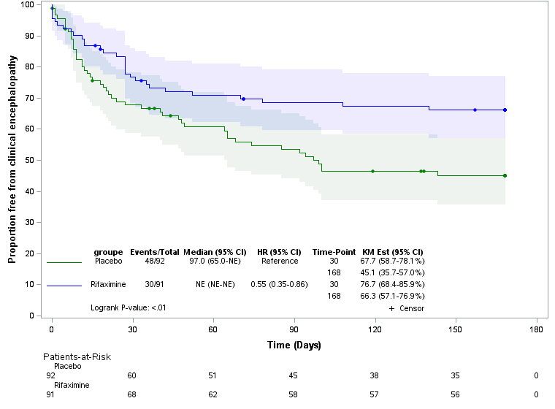
Rifaximina para prevención de encefalopatía hepática en pacientes tratados con TIPS: ECA multicéntrico.
Objetivo:
La eficacia de la rifaximina en la prevención secundaria de encefalopatía hepática clínica (EH) esta bien documentada, pero su eficacia para la prevención de un primer episodio en pacientes tratados con TIPS no está bien establecida.
Métodos:
Asignamos aleatoriamente a 183 pacientes tratados con TIPS para recibir ya sea rifaximina, a dosis de 600 mg dos veces al día o placebo, iniciado
15 días previo a TIPS y por 6 meses después del procedimiento. El desenlace primario fue la ocurrencia de por lo menos un episodio de EH en 6 meses (valoración doble ciego).
Hallazgos principales:
La probabilidad a 6 meses de estar libre de EH fue 66.3% en el grupo de rifaximina comparado con 45.1% en el grupo de placebo (p<0.01). El OR estratificado por clase de Child Pugh y un episodio previo de EH antes de TIPS fue 0.48% IC 95% [0.27-0.87; p=0.01]
Conclusiones:
En pacientes tratados con TIPS, mostramos que el uso preventivo de rifaximina esta asociado con menor riesgo de EH clínica.
Bureau C, et al., Abstract 14
Notes:
14
RIFAXIMIN FOR THE PREVENTION OF HEPATIC ENCEPHALOPATHY IN PATIENTS TREATED BY TIPS : A MULTICENTER RANDOMIZED PLACEBO-CONTROLLED TRIAL
Dr. Christophe Bureau^{1,2}, Dr. Caroline Jezequel³, Dr. Isabelle Archambault⁴, Prof. Dominique Thabut⁵, Dr. Sebastien Dharancy⁶, Jean Marc Perarnau⁷, Dr. Frederic Oberti⁸, Dr. Patrick Borentain⁹, Nathalie Ganne Carrie¹⁰, Dr. Aurelie Plessier¹¹, Dr. Nicolas Carbonell Sr.¹², Vanessa Rousseau², Dr. Agnes Sommet² and Prof. Jean-Marie Peron², (1)Service d’Hépato-Gastroentérologie, Hôpital Purpan CHU Toulouse, Université Paul Sabatier, Toulouse, France, (2)CHU Toulouse, (3)CHU Rennes, (4)CHU Nantes, (5)Sorbonne Université, Brain-Liver Pitié-Salpêtrière Study Group (BLIPS), Hôpital De La Pitié Salpêtrière, Assistance Publique-Hôpitaux De Paris, Paris, France & Inserm Umr_S 938, CDR Saint-Antoine & Institut De Cardiométabolisme Et Nutrition (ICAN), (6)Liver Unit, CHU Lille, (7)CHU Trousseau, Service d’Hépato-Gastroentérologie, Tours, France, (8)Angers University Hospital, (9)CHU Marseille, (10)CHU Jean Verdier, (11)CHU Beaujon, (12)CHU Saint Antoine
Background:
The efficacy of rifaximine in secondary prevention of hepatic encephalopthy (HE) is well documented, but its efficacy for prevention of a first episode in patients treated by TIPS is not established.
Methods:
In this randomized, double-blind, placebo-controlled trial, we randomly assigned patients who were treated by TIPS to receive either rifaximin, at a dose of 600 mg twice daily or placebo, started 15 days before TIPS and for 6 months after the procedure. Patients were followed for a period of one year (6 months after stopping rifaximin). The primary efficacy end point was the probability of remaining free of HE at 6 month.
Results:
Between 10/2013 and 06/2016, 186 patients (144 males/44 females, mean age 59 9± 9 years) were included. Indications of TIPS were recurrent ascites or prevention of rebleeding in 86 % and 16 % of cases, respectively. Etiology of cirrhosis was alcoholic in 70 % of patients. Mean Meld and Child Pugh scores were 11.9 ± 3.9 and 8.1 ± 1.1, respectively. Twenty percent of patients have been already experienced at least one episode of HE before TIPS. The mean follow-up was 310 ± 120 days.
The 6-month probability of being free of HE was 59.1 % [49.8-70.2] in the rifaximin group compared to 44.2 % [34.9-56.1] in the placebo group (p=0.05). Transplant free survival at 6 month was 93.2 % [88.0-98.6] in the rifaximin group compared to 84.0 % [76.7-92.1] in the placebo group (p=0.05).
Conclusion:
In patients treated by TIPS, we showed that the use of preventive rifaximin is associated with a lower risk of HE and a higher rate of transplant free survival during the 6-month period of treatment after the procedure.
Disclosures
Christophe Bureau – Gore: Speaking and Teaching; Abbvie: Board Membership; Norgine: Consulting; AlfaWasserman: Consulting
Jean Marc Perarnau – Gore and Associates: Speaking and Teaching
The following people have nothing to disclose: Isabelle Archambault, Dominique Thabut, Patrick Borentain, Nathalie Ganne Carrie, Nicolas Carbonell
Disclosure information not available at the time of publication: Caroline Jezequel, Sebastien Dharancy, Frederic Oberti, Aurelie Plessier, Vanessa Rousseau, Agnes Sommet, Jean-Marie Peron

Slide 7
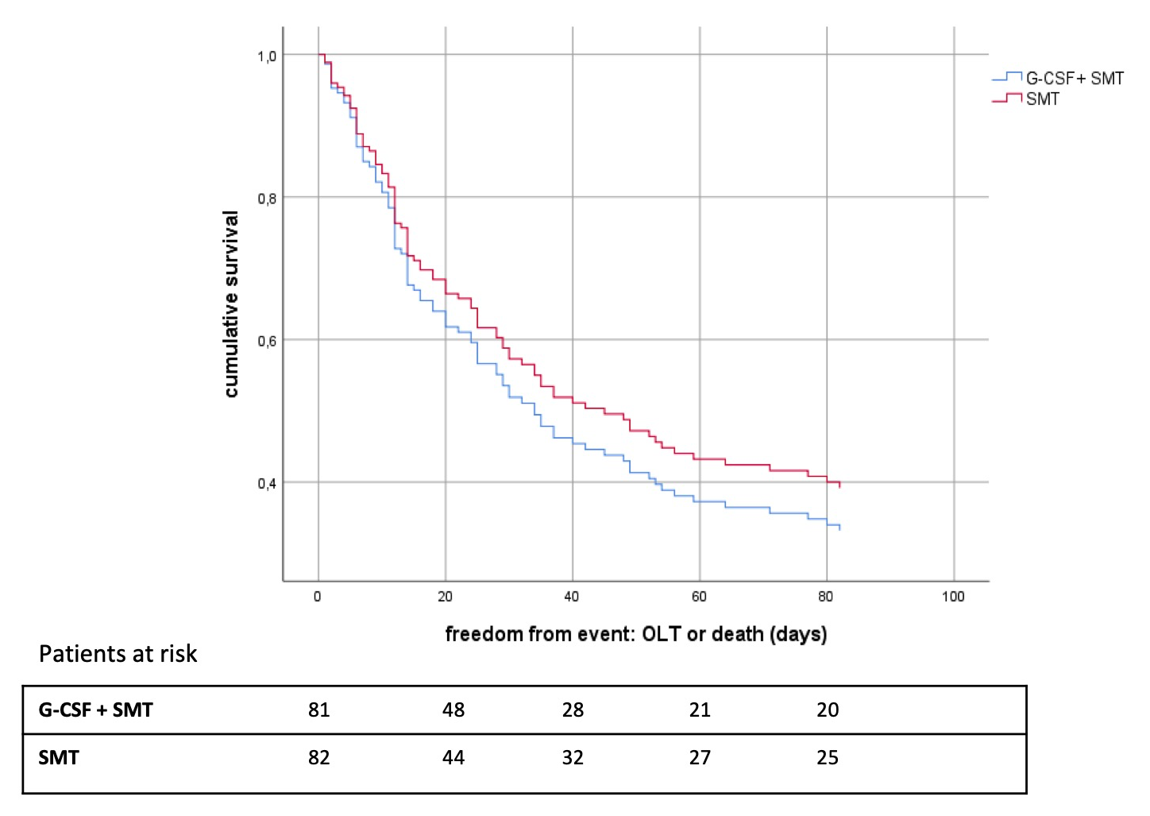
G-CSF para tratar falla hepática crónica agudizada (ensayo GRAFT): Análisis interino del primer ensayo multicéntrico Europeo
Hipótesis:
El factor estimulante de colonias de granulocitos (G-CSF) mitiga la lesión orgánica en falla hepática crónica agudizada (ACLF).
Métodos:
Estudio controlado, prospectivo, abierto a dos brazos en 163 pacientes comparando la eficacia de G-CSF contra la terapia médica estándar (TME) en pacientes con ACLF.
Principales Hallazgos:
Pacientes tratados con G-CSF tuvieron una sobrevida a 90 días libre de trasplante de 40.7%, sin observar diferencia con TME 48.8% con HR de 1.177 (95% CI 0.778; 1.782) (p=0.44).
Conclusiones:
Distinto a publicaciones previas de ensayos clínicos más pequeños estos resultados muestran que el G-CSF no tienen efecto benéfico en el desenlace de pacientes con ACLF.
Cumulative Transplant-Free Survival
90 Days After Study Inclusion
Engelmann C, et al., Abstract 17
Notes:
17
GRANULOCYTE-COLONY STIMULATING FACTOR (G-CSF) TO TREAT ACUTE-ON-CHRONIC LIVER FAILURE (GRAFT TRIAL): INTERIM ANALYSIS OF THE FIRST RANDOMISED EUROPEAN MULTICENTRE TRIAL
Dr. Cornelius Engelmann^{1,2}, Adam Herber¹, Prof. Tony Bruns^{3,4}, Prof. Ingolf Schiefke⁵, Dr. Alexander Zipprich⁶, Dr. Anett Schmiedeknecht⁷, Stefan Zeuzem⁸, Prof. Tobias Goeser⁹, Prof. Ali E Canbay¹⁰, Christoph Berg¹¹, Dr. Jonel Trebicka^{8,12,13,14}, Frank Erhard Uschner^{8,15}, Dr. Tobias Mueller¹⁶, Dr. Niklas Aehling¹, Dr. Sandra Krohn¹, Dr. Moritz Schmelzle¹⁷, Dr. Katrin Splith¹⁷, Prof. Frank Lammert¹⁸, Prof. Christian M Lange¹⁹, Christoph Sarrazin^{8,20}, Prof. Christian Trautwein³, Dr. Michael P. Manns^{21,22}, Prof. Dieter Haeussinger²³, Dr. Jan Pfeiffenberger²⁴, Prof. Peter R. Galle²⁵, Dr. Annegret Franke⁷ and Thomas Berg²⁶, (1)Section of Hepatology, Clinic for Gastroenterology and Rheumatology, University Hospital Leipzig, (2)Liver Failure Group, Institute for Liver and Digestive Health, University College London Medical School, (3)Department of Medicine III, Aachen University Hospital, (4)University Hospital Jena, Clinic for Internal Medicine IV, (5)Clinic for Gastroenterology, Hepatology and Endocrinology, St. Georg Hospital, (6)University Hospital for Internal Medicine 1, Martin-Luther-University Halle-Wittenberg, (7)Centre for Clinical Research (ZKS), University Leipzig, (8)Department of Internal Medicine I, University Hospital Frankfurt, (9)Clinic for Gastroenterology and Hepatology, University Hospital Cologne, (10)Department of Gastroenterology, Hepatology and Infectiology, Otto-Von-Guericke University Magdeburg, (11)University Hospital Tuebingen, Germany, (12)Department of Gastroenterology and Hepatology, Odense University Hospital, (13)European Foundation for the Study of Chronic Liver Failure, (14)Department of Internal Medicine I, University of Bonn, (15)Internal Medicine I, University Hospital Bonn, (16)Clinic for Hepatology and Gastroenterology, Charite - University Hospital Berlin, (17)Clinic for Surgery, Charite - University Hospital Berlin, (18)Department of Medicine II, Saarland University Medical Center, (19)Clinic for Gastroenterology and Hepatology, University Hospital Essen, (20)Medical Clinic 2, St. Josefs Hospital Wiesbaden, (21)German Center for Infection Research (DZIF), Partner-Site Hannover-Braunschweig, Hannover, Germany, (22)Department of Gastroenterology, Hepatology and Endocrinology, Hannover Medical School, (23)Clinic and Policlinic of Gastroenterology, Hepatology and Infectious Disease, Heinrich Heine University Duesseldorf, (24)Department of Gastroenterology and Hepatology, University Hospital Heidelberg, (25)1. Medical Department, Johannes Gutenberg University Mainz, (26)Department of Gastroenterology and Rheumatology, Section of Hepatology, University Hospital Leipzig
Background:
The acute-on-chronic liver failure (ACLF) is a severe complication of cirrhosis characterised by immune dysfunction and high mortality. Granulocyte-colony stimulating factor (G-CSF) mobilises immunomodulatory stem and immune cells and has been proposed as therapy for ACLF. We therefore conducted the first multicentre randomised trial.
Methods:
In this prospective, controlled, open-label 2-armed study 163 patients with ACLF according to the EASL-CLIF criteria without malignancies or septic shock were randomised in 18 trial centres between 02/2016 and 01/2019 in a 1:1 ratio to receive either standard medical therapy (SMT) or SMT plus G-CSF (12 injections with 5 µg/kg for 5 days daily, then every 3 days). The primary efficacy endpoint was 90-day transplant free survival (TFS90). The interim analysis, performed by Cox regression models, was scheduled when 50% of the patients reached the primary endpoint or an event-free 90-day follow-up.
Results:
The baseline characteristics were not different between the groups. Male was the predominant gender (62.6%), the mean (SD) age was 55.6 (9.9) years, and the mean MELD score was 24.8 (6). In total 42.3% of the patients presented with ACLF grade 1, 38% with ACLF grade 2 and 15.3% with ACLF grade 3. Bacterial infections (54%) and alcoholic hepatitis (52%) were the predominant precipitating events.
The primary endpoint analysis revealed that patients treated with G-CSF had a 90-day transplant-free survival of 40.7% which was not different to 48.8% in SMT with a hazard ratio of 1.177 (95% CI 0.778;1.782) (p=0.44) (fig. 1). The overall survival did also not differ between the groups (HR 1.047 (95% CI 0.717;1.587); G-CSF 37% vs SMT 42.7%; p=0.749). Multivariate analysis considering further covariates showed that neither ACLF grade nor the presence of alcoholic hepatitis, infections or ACLF as defined by the APASL criteria did impact on treatment efficacy (HR 1.143 (95% CI 0.751;1.741); p=0.532). In subgroups of patients who survived >7 days (n=143; HR 0.976 (95% CI 0.611;1.561); p=0.921) G-CSF also failed to improve survival. Four drug related serious adverse reactions occurred in the G-CSF group.
Conclusion:
This interim analysis of the first multicentre trial reveals that G-CSF has no therapeutic effect in ACLF, which is in obvious contrast to the results from smaller clinical trials published previously. As a consequence, the study was prematurely terminated due to futility after conditional power calculation.
Disclosures:
Cornelius Engelmann – German Research Foundation (DFG): Grant/Research Support; Novartis: Grant/Research Support; Merz: Grant/Research Support
Tony Bruns – Intercept Pharmaceuticals: Advisory Committee or Review Panel; Intercept Pharmaceuticals: Speaking and Teaching; Norgine: Speaking and Teaching; Abbvie: Speaking and Teaching
Christoph Berg – AbbVie: Speaking and Teaching; MSD: Advisory Committee or Review Panel; Gilead: Speaking and Teaching; Intercept: Advisory Committee or Review Panel
Jonel Trebicka – Abbvie: Speaking and Teaching; MSD: Speaking and Teaching; Gilead: Speaking and Teaching; Falk: Speaking and Teaching; Bayer: Speaking and Teaching; Alexion: Speaking and Teaching; Versantis: Speaking and Teaching; Sequana Medical: Speaking and Teaching; Norgine: Speaking and Teaching; W.L. Gore & Associates: Speaking and Teaching; Deutsch
Moritz Schmelzle – Merck: Speaking and Teaching; ERBE: Speaking and Teaching; Ethicon: Speaking and Teaching
Christian M Lange – Abbvie: Speaking and Teaching; Gilead: Speaking and Teaching; MSD: Speaking and Teaching; Novartis: Speaking and Teaching; Falk: Speaking and Teaching; Eisai: Speaking and Teaching; Norgine: Speaking and Teaching
Michael P. Manns – Abbvie, BMS, Eiger, Falk, Gilead, Intercept, Merck (MSD), Roche: Grant/Research Support; Abbvie, BMS, Falk, Gilead, Merck (MSD), Roche: Speaking and Teaching; Abbvie, BMS, Curevac, Eiger, Enyo, Falk, Gilead, Intercept, MSD, Novartis, Roche, Preglem, Gedeon Richter, Allergan: Consulting; Abbvie, Biotest, BMS, Boehringer Ingelheim, Gilead, G
Peter R. Galle – Bayer, BMS, MSD; AstraZeneca, Lilly, Sirtex, Roche, Eisai, Ipsen: Advisory Committee or Review Panel
Thomas Berg – Merck/MSD: Consulting; IPSEN: Advisory Committee or Review Panel; IPSEN: Grant/Research Support; IPSEN: Speaking and Teaching; Sequana Medical: Advisory Committee or Review Panel; Sequana Medical: Speaking and Teaching; Sequana Medical: Grant/Research Support; Intercept: Advisory Committee or Review Panel; Intercept: Grant/Research Support
The following people have nothing to disclose: Adam Herber, Ingolf Schiefke, Alexander Zipprich, Ali E Canbay, Frank Lammert, Jan Pfeiffenberger
Disclosure information not available at the time of publication: Anett Schmiedeknecht, Stefan Zeuzem, Tobias Goeser, Frank Erhard Uschner, Tobias Mueller, Niklas Aehling, Sandra Krohn, Katrin Splith, Christoph Sarrazin, Christian Trautwein, Dieter Haeussinger, Annegret Franke

Slide 8
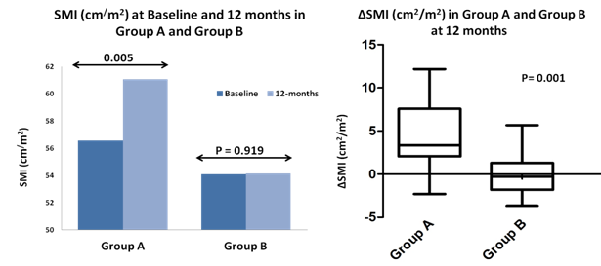
Efecto a largo plazo de la terapia con hormona de crecimiento (GH) en cirrosis descompensada.
Objetivo:
Estudiar la seguridad y eficacia del tratamiento con GH) y sus efectos en desnutrición, metabolismo del nitrógeno, y cambios hormonales en pacientes con cirrosis descompensada (CD).
Métodos:
Treinta y tres pacientes con CD aleatorizados para recibir ya sea terapia medica estándar (TME) más GH (1 UI/día subcutánea e incremento a 2 UI/día por titulación de dosis acorde a niveles de IGF-1) (Grupo A; n=17) o TME sola (Grupo B; n=17)
Parámetros de desnutrición [índice de músculo esquelético (IME), índice de masa corporal (IMC), circunferencia muscular brazo medio (MAMC), fuerza de estrechamiento de mano (HGS), cambios hormonales, y balance de nitrógeno fueron estudiados basalmente y a los 3, 6, 9 y 12 meses.
Conclusiones:
La terapia con GH es segura y efectiva en pacientes sin CD.
El uso a largo plazo de GH mejora la desnutrición (SMI, IMC, MAMC y HGS) y el balance de nitrógeno y disminuye la resistencia a GH.
Various Parameters at Baseline and 12 Months
Parameters | Group A |  |  | Group B
 | Baseline | 12-months | P-value | Baseline | 12-months | P-value
BMI(Kg/m²) | 22.9±3.0 | 25.7±3.2 | 0.02 | 21.2±5.8 | 22.6±4.2 | 0.87
MAMC (cm) | 22.6±2.5 | 27.5±8.1 | 0.02 | 22.7±7.8 | 23.79±8.9 | 0.89
Handgrip strength (Kg) | 21.1±5.8 | 27.5±6.4 | 0.01 | 22.5±5.9 | 23.7±6.6 | 0.58
IGF-1(ng/ml) | 0.3±0.1 | 6.2±4.5 | 0.00 | 0.4±0.1 | 0.5±1.5 | 0.68
GH(IU/ml) | 565.7±355.1 | 185.1±120.6 | 0.04 | 498.8±355.1 | 402.1±150.6 | 0.67
Nitrogen Balance (g/day) | 3.02±6.4 | 8.43.±6.2 | 0.09 | 2.98±5.9 | 3.58±6.3 | 0.45
Kumari S, et al., Abstract 50
Notes:
50
LONG-TERM EFFECT OF GROWTH HORMONE THERAPY IN DECOMPENSATED CIRRHOSIS
Sunita Kumari¹, Bidyalaxmi Leishangthem¹, Dr. Akash Singh¹, Dr. Arka De¹, Prof. Naveen Kalra² and Prof. Virendra Singh¹, (1)Hepatology, Pgimer, (2)Radiodiagnosis and Imaging, Pgimer
Background:
Malnutrition is common in decompensated cirrhosis (DC) and is associated with a poor prognosis. It is commonly associated with protein catabolism which is accompanied by severe growth hormone (GH) resistance leading to overall effective deficiency of GH. The supplementation of GH may revert this process. The effect of long-term GH therapy on the malnutrition, nitrogen metabolism and hormonal changes in these patients is not known. Therefore, we plan to study the safety and efficacy of GH therapy and its effect on malnutrition, nitrogen metabolism and hormonal changes in patients with DC.
Methods:
Thirty-four patients with DC were openly randomized to either standard medical therapy (SMT) plus GH (started at a dose of 1IU/day subcutaneously and increased to 2 IU/day by titrating the dose according to IGF-1 levels) (GH Group; n=17) or SMT alone (Control Group; n=17). Patients were followed-up monthly for 12 months. We studied clinical scores [Child Turcotte Pugh score (CTP) and Model for End-stage Liver Disease (MELD)], various parameters of malnutrition [body mass index (BMI), mid-arm muscle circumference (MAMC), hand grip strength (HGS) and skeletal muscle index (SMI)], nitrogen balance and hormonal assays [Growth Hormone, Insulin like Growth Factor -1 (IGF-1) and Acid labile subunit (ALS)] at baseline and then at 12 months.
Results:
The baseline characteristics were comparable between two groups. There was significant improvement in malnutrition parameters [BMI (22.92±3.03 vs 25.71±3.20, p=0.016), MAMC (22.6±2.5 vs 27.5±8.1 cm, p=0.02),HGS (21.10±5.77 vs 27.5±6.4 kg, p=0.006) and SMI (56.6±8.4 vs 60.6 ±9.5 cm²/m², p=0.005)] and CTP score (7.7±2.2 vs 6.2±1.4 p=0.024) in GH group at 12 months. There was a trend of improvement in nitrogen balance (3.0±6.4 vs 8.43.±6.16 g/day, p=0.09 ) in GH group at 12 months. IGF1(0.347±0.146 vs 6.154±4.517 ng/ml, p=0.0001), GH(565.70 ±355.11 vs 185.12±120.57 µg/ml, p=0.041) and ALS(14.50±8.56 vs 36.232±14.28 ng/ml, p=0.000) levels also improved significantly in GH group at 12 months. There was no significant improvement in clinical scores, malnutrition parameters and nitrogen balance in control group. There were no adverse events related to long-term use of growth hormone in these patients.
Conclusion:
GH therapy is safe and effective in patients with DC and long-term use improves CTP, malnutrition and nitrogen balance. However, a double blind study is required to validate our findings. (NCT03420144)
Disclosures:
The following people have nothing to disclose: Sunita Kumari, Bidyalaxmi Leishangthem, Akash Singh, Arka De, Naveen Kalra, Virendra Singh

Slide 9

Cambios en la fragilidad están asociados con mortalidad en lista de espera. Del estudio de Evaluación Funcional en Trasplante Hepático (FrAILT).
Objetivo:
Evaluar cambios en fragilidad en pacientes con cirrosis y asociación con mortalidad en lista de espera (muerte + retiro de lista)
Métodos:
Fragilidad medida usando el Índice Objetivo de Fragilidad hepática (LFI) consistente en fuerza de estrechamiento de mano, levantamiento de silla y pruebas de balance.
Principales Hallazgos:
Cada cambio de 0.1 unidades en ΔLFI fue asociado con aumento 2 veces del riesgo de mortalidad en lista de espera (IC95% 1.4-3.1; p<0.001) independiente al LFI y MELDNa basal.
Conclusiones:
Nuestra información apoya la medición objetiva de fragilidad en pacientes con cirrosis y establece la fundación para intervenciones dirigidas a revertir o prevenir la fragilidad.
Lai JC, et al., Abstract 54
Notes:
54
CHANGES IN FRAILTY AND ITS IMPACT ON MORTALITY: A MULTI-CENTER, LONGITUDINAL STUDY OF >1000 PATIENTS WITH CIRRHOSIS [FUNCTIONAL ASSESSMENT IN LIVER TRANSPLANTATION (FRAILT) STUDY]
Dr. Jennifer Cindy Lai, MD, University of California, San Francisco, Dr. Matthew R. Kappus, Division of Gastroenterology, Duke University, Jennifer Dodge, Department of Surgery, University of California, San Francisco, Dr. Michael A. Dunn, Medicine, University of Pittsburgh, Dr. Michael Volk, Loma Linda University Medical Center, Dr. Andres Duarte-Rojo, Division of Gastroenterology and Hepatology, University of Arkansas for Medical Sciences, Dr. Daniel R Ganger, Northwestern Memorial Hospital, Dr. Robert S. Rahimi, Baylor University Medical Center, Charles E McCulloch, Epidemiology, University of California, San Francisco, Dr. Christine Haugen, Johns Hopkins Hospital, Mara McAdams DeMarco, Johns Hopkins Medical Institute, Dorry Segev, Surgery, Johns Hopkins Hospital, Dr. Daniela Ladner, Transplant Surgery, Northwestern University Feinberg School of Medicine, Dr. Elizabeth C. Verna, MD, MS, Transplant Hepatology, Columbia University Medical Center and Multi-Center Functional Assessment in Liver Transplantation (FrAILT) Study
Background:
Frailty is predictive of death in patients with cirrhosis, but studies, to date, have largely been limited to assessments at a single time point. We aimed to evaluate changes in frailty over time (ΔLFI) and its association with death/delisting for sickness.
Methods:
Adults with cirrhosis listed for liver transplantation without hepatocellular carcinoma at 8 U.S. centers underwent ambulatory frailty testing with the Liver Frailty Index (LFI; calculated from grip strength, chair stands, and balance) at baseline and follow-up visits. We used multilevel linear mixed effects regression to model and predict ΔLFI per 3 months based on age, gender, MELDNa, ascites, and hepatic encephalopathy (HE). Competing risk regression evaluated the subhazard ratio (sHR) of baseline LFI and predicted ΔLFI on death/delisting, with transplantation as the competing risk. To determine if the sHR for MELDNa changed significantly after adjusting for LFI, difference in MELDNa regression coefficients were compared between models with and without LFI and ΔLFI using bootstrap methods (100 replications).
Results:
We analyzed 2,851 visits from 1,093 patients with cirrhosis: mean (SD) MELDNa 19 (6); baseline LFI 4.0 (0.8). After a median follow-up of 11 months (IQR 5-21), 223 (20%) died/were delisted for sickness. In adjusted mixed effects models, mean (SD) ΔLFI per 3 months was 0.02 (0.02) [p<0.001]: 49% worsened moderately/severely (ΔLFI≥0.02), 35% worsening slightly (ΔLFI between 0-0.02), and 16% improved (ΔLFI<0). The cumulative incidence of death/delisting increased by worsening ΔLFI group [Fig]. In competing risk regression adjusted for age, height, MELDNa, and albumin, a 0.1 unit change in both LFI [sHR 1.07 (95% CI 1.05-1.10)] and ΔLFI per 3 months [sHR 2.04 (95% CI 1.35-3.09)] were associated with death/delisting. In successive competing risk models, adding LFI (Table Model B) or LFI plus ΔLFI (Table Model C) significantly attenuated the association b/n MELDNa and death/delisting (Table, p<0.001 for difference in MELDNa coefficients).
Conclusion:
Frailty is dynamic: the majority (84%) of patients with cirrhosis awaiting liver transplantation experienced worsening of frailty within 3 months. Δfrailty per 3 months was significantly associated with death/delisting independent of baseline frailty and MELDNa. Notably, patients who experienced improvements in frailty over time had a lower risk of death/delisting than those who experienced worsening frailty. The addition of frailty and Δfrailty per 3 months attenuated the association between MELDNa and death/delisting. Our data support the longitudinal measurement of frailty, using the Liver Frailty Index, in patients with cirrhosis and lay the foundation for interventional work aimed at reversing – or even preventing – frailty. [Grant support: P30DK026743, K23AG048337, R01AG059183]
Disclosures:
Jennifer Cindy Lai – Axcella Health, Inc: Consulting
Michael A. Dunn – Axcella Health, Inc: Consulting
Michael Volk – Biovie: Consulting
Andres Duarte-Rojo – Axcella: Advisory Committee or Review Panel; Echosens: Grant/Research Support
Daniel R Ganger – Gilead: Speaking and Teaching; Hepquant: Consulting
Dorry Segev – Sanofi: Speaking and Teaching; Novartis: Speaking and Teaching
Elizabeth C. Verna – Salix: Grant/Research Support; Gilead: Advisory Committee or Review Panel
The following people have nothing to disclose: Matthew R. Kappus, Jennifer Dodge, Robert S. Rahimi, Christine Haugen
Disclosure information not available at the time of publication: Charles E McCulloch, Mara McAdams DeMarco, Daniela Ladner

Slide 10
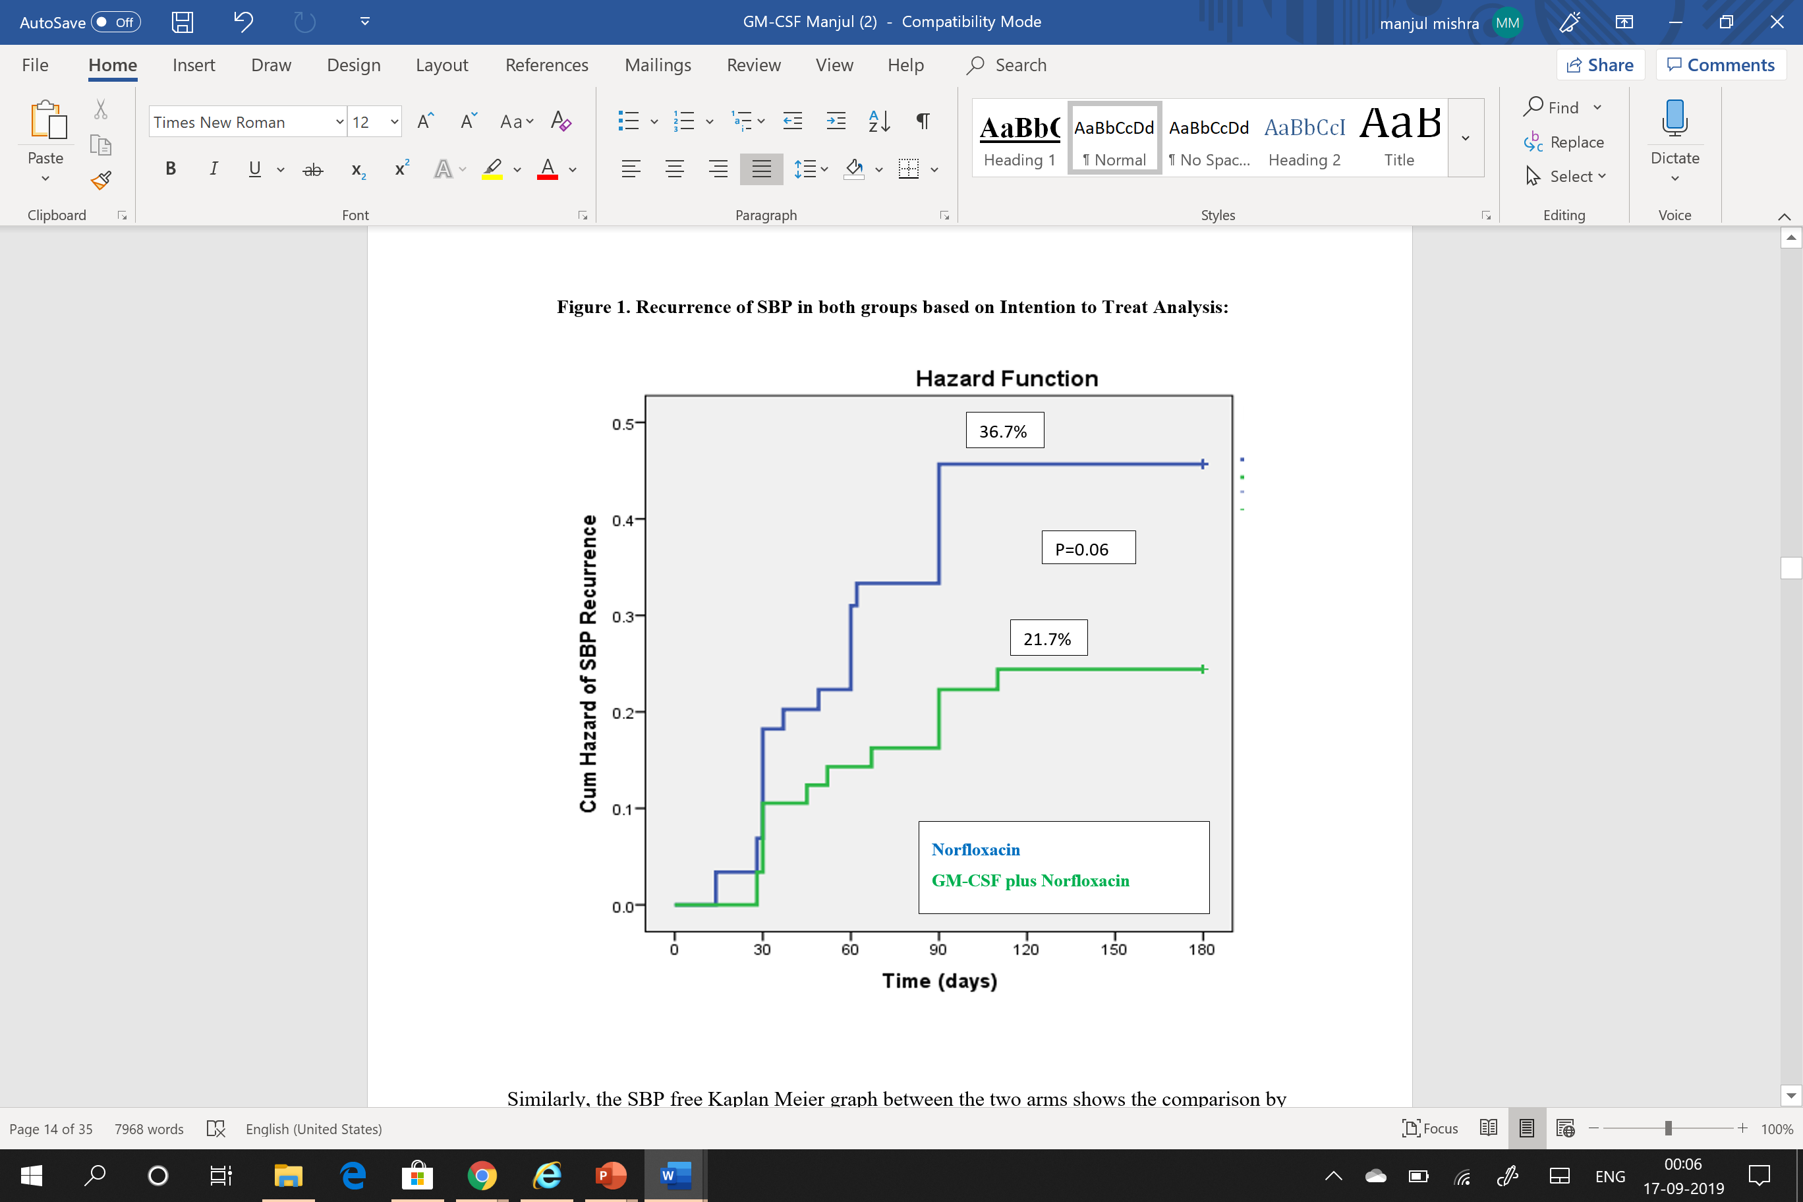
Comparación de la eficacia del factor estimulante de colonias de granulocitos y macrófagos (GM-CSF) y norfloxacino para profilaxis secundaria de peritonitis bacteriana espontánea – Estudio controlado aleatorizado
Objetivo:
Comparar la terapia inmunoestimulatoria usando GM-CSF con norfloxacino para profilaxis secundaria de PBE.
Métodos:
Estudio abierto, aleatorizado con pacientes cirróticos descompensados (n=120) con resolución completa de PBE bajo terapia antibiótica estándar, recibieron norfloxacino 400 mg/día [Grupo A, n=60) o en adición GM-CSF 1.5 mcg/kg en infusión durante 4 horas cada 15 días [Grupo B, n=60).
Se analizaron la recurrencia de PBE a 6 meses, complicaciones nuevas, sobrevida general y efectos adversos.
Conclusiones:
La administración quincenal de GM-CSF fue segura y más efectiva para prevenir recurrencia que la terapia diaria con norfloxacino (p=0.06)
Recurrence of SBP in Both Groups Based on Intention to Treat Analysis
Hazard Function
Cumulative Hazard of SBP Recurrence
Mishra M, et al., Abstract 97
Time (Days)
Notes:
97
COMPARISON OF THE EFFICACY OF GRANULOCYTE MACROPHAGE-COLONY STIMULATING FACTOR (GM-CSF) AND NORFLOXACIN FOR SECONDARY PROPHYLAXIS OF SPONTANEOUS BACTERIAL PERITONITIS – A RANDOMIZED CONTROLLED TRIAL
Dr. Manjul Mishra Jr.¹, Prof. Shiv Kumar Sarin, MD, FAASLD², Ashok K Choudhury³ and Dr. Ankur Jindal¹, (1)Hepatology, Institute of Liver and Biliary Sciences, New Delhi, (2)Hepatology, Institute of Liver and Biliary Sciences, (3)Department of Hepatology, Institute of Liver & Biliary Sciences
Background:
Long-term norfloxacin has been used for secondary prophylaxis of spontaneous bacterial peritonitis (SBP) with growing evidence of multidrug resistant infection. Immunomodulation by GM-CSF could prevent recurrent SBP and improve survival.We considered comparing immunostimulatory therapy using GM-CSF with norfloxacin for secondary prophylaxis of SBP in patients with decompensated cirrhosis.
Methods:
In an open-label, randomized trial (NCT03702426), decompensated cirrhotic patients (n=120) who fulfilled the inclusion criteria (age 18-70 years with complete resolution of SBP on standard antibiotic therapy)received oral norfloxacin 400 mg/day [Group A, n=60] or GM-CSF 1.5mcg/kg infusion over 4 hour every 15 days [Group B, n=60]. Recurrence of SBP at 6 months, new onset complications, overall survival and adverse effects of the drugs were studied. All patients were counselled for liver transplantation.
Results:
Baseline characteristics of both groups were comparable, {Gr A vs B: Age-49.7±9.4 and 50.1±10.9 years,ascitic fluid cell count-1178 (386-2942) and 1311 (412-3254) cells/mm³, MELD-19.8±7.5 and 20.0±5.8, respectively}. Recurrence of SBP occurred at median of 90 (range 16-120) days. As per intention to treat analysis,SBP recurred in 29.2% (35/120) patients [95% CI:21.2-38.2], 36.7% (n=22) [95% CI:24.6-50.1] in norfloxacin and 21.7% (n=13) [95% CI:12.1-34.2] in the GM-CSF arm (p=0.06). 13 patients developed new onset acute kidney injury (AKI); 8 in norfloxacin and 5 in GM-CSF arm (p=0.42). Fifty one (89.4%) and 46 (88.4%) patients survived in the GM-CSF and norfloxacin group respectively at day 90 (p=0.84). On univariate analysis,TLC at baseline,ascitic fluid protein at resolution of index SBP, worsening of HE and new onset AKI predicted recurrence of SBP. On multivariate analysis,only ascitic fluid protein at resolution was an independent predictor of SBP recurrence [OR-26.44, 95% CI 49-469.9, p=0.03]. The neutrophil to lymphocyte (N/L) ratio was calculated at 6 months which was 1.97±0.22 in the norfloxacin arm and 2.01±0.30 in the GM-CSF arm (p=0.47). A total of nine (15.8%) patients developed minor side effects in the GM-CSF plus norfloxacin arm.
Conclusion:
SBP recurs in one in 5 patients with decompensated cirrhosis despite secondary prophylaxis protocols.Fortnightly GM-CSF was safe and more effective in preventing recurrence than daily norfloxacin therapy (p=0.06). Ascitic fluid protein at resolution of index SBP was found to be an independent predictor of recurrence of SBP.
Disclosures:
The following people have nothing to disclose: Manjul Mishra, Shiv Kumar Sarin, Ankur Jindal
Disclosure information not available at the time of publication: Ashok K Choudhury

Slide 11
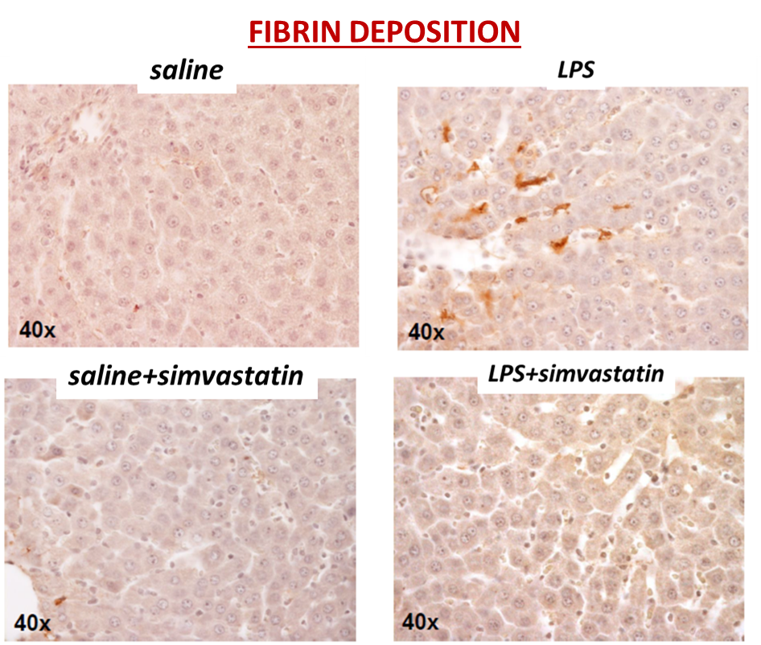
Propiedades antitrombóticas de simvastatina en el endotelio y prevención de microtrombosis hepática post-exposición a lipopolisacáridos.
Fibrin Deposition
Objetivo:
Explorar los efectos protectores endoteliales de la simvastatina contra la microtrombosis vascular hepática causada por endotoxemia.
Métodos:
Ratas Wistar expuestas a LPS (5 mg/kg una dosis IV) vs salina.
Condiciones experimentales: placebo y simvastatina (25 mg/kg/24 h, oral, 3 días antes de inyección de LPS/salina)
Hallazgos principales:
La simvastatina previno el depósito de fibrina inducido por LPS (ver figura). Esto ocurrió ya que esta preserva la expresión de trombomodulina en las células sinusoidales (inmunohistoquímica).
Los LPS indujeron un perfil hemorrágico periférico (análisis ROTEM) que correlaciona con el grado de depósito de fibrina intrahepático (R=0.887, p=0.001) pero fue revertido por simvastatina.
Conclusiones:
La simvastatina puede prevenir la coagulopatía causada por endotoxemia.
La Mura V, et al., Abstract 102. This study was granted by Gilead Sciences Research Scholar Program.
Notes:
102
ANTITHROMBOTIC PROPERTIES OF SIMVASTATIN ON THE ENDOTHELIUM AND PREVENTION OF LIVER MICROTHROMBOSIS AFTER EXPOSURE TO LIPOPOLYSACCHARIDE
Dr. Vincenzo La Mura^{1,2,3}, Prof. Nicoletta Gagliano¹, Dr. Francesca Arnaboldi¹, Dr. Patrizia Sartori¹, Prof. Patrizia Procacci¹, Dr. Eleonora Liguori¹, Dr. Niccolò Bitto³, Prof. Giuseppe Ristagno⁴, Dr. Daniele Dondossola⁵, Prof. Francesco Salerno¹, Prof. Armando Tripodi^{3,6}, Massimo Colombo⁷ and Prof. Flora Peyvandi^{3,6}, (1)Dipartimento Di Scienze Biomediche per La Salute, Università Degli Studi Di Milano, Milan, Italy, (2)C.R.C. "a.M. e a. Migliavacca" per Lo Studio e La Cura Della Malattie Del Fegato, Università Degli Studi Di Milano, Milan, Italy, (3)Fondazione I.R.C.C.S. Ca’ Granda, Ospedale Maggiore Policlinico, U.O.C. Medicina Generale Emostasi e Trombosi, Milan, Italy, (4)Dipartimento Di Ricerca Cardiovascolare, Istituto Di Ricerche Farmacologiche Mario Negri Irccs, Milan, Italy, (5)General and Liver Transplant Surgery Unit - Fondazione I.R.C.C.S. Ca' Granda, Ospedale Maggiore Policlinico, (6)Dipartimento Di Fisiopatologia Dei Trapianti, Università Degli Studi Di Milano, Milan, Italy, (7)Center for Translational Hepatology Research, Clinical and Research Center Humanitas Hospital, Rozzano, Italy
Background:
Microvascular thrombosis has an important role on the development of organ failure in sepsis and endothelial dysfunction represents a key-pathogenic mechanism of this process. Simvastatin preserves the anti-inflammatory and the vasodilator properties of liver endothelial cells in rats exposed to lipopolysaccharide (LPS) and deserves potential anti-thrombotic effects. This study investigates the haemostatic changes induced by LPS and explores the protective effects of simvastatin against liver vascular microthrombosis elicited by endotoxemia.
Methods:
Rats exposed to LPS (5mg/Kg one i.p. dose) were compared with saline in the presence or absence of pre-treatment with simvastatin (25 mg/kg/24 h, orally, 3 days before LPS/saline injection). Morphological studies were performed by light- and electron-microscopy analysis to show intravascular fibrin deposition, vascular endothelial structure and liver damage. Peripheral- and organ-haemostatic profile were analysed using, respectively, ROTEM on whole blood and western-blot and immunoistochemistry of thrombomodulin (TM) and factor VIII (FVIII) on liver biopsy.
Results:
LPS induced fibrin deposition and liver vascular microthrombosis combined with high expression of FVIII and loss of expression of TM at sinusoidal level. These changes were associated with increasing markers of cellular stress (eosinophilia) and irreversible liver damage (necrosis). ROTEM analysis displayed a haemorrhagic profile in the peripheral blood that correlated with the degree of intrahepatic fibrin deposition (R=0.887, p=0.001). Simvastatin was able to prevent LPS-induced fibrin deposition by preserving TM expression at sinusoidal cells and completely reverted the peripheral haemorrhagic profile associated with endotoxemia. The endothelial protective effect seen in our experiments was associated with a significant reduction of necrotic liver damage, but did not impact on the degree of eosinophilia.
Conclusion:
Simvastatin may preserve the antithrombotic function of sinusoidal endothelial cells after LPS exposure. The results of our study suggest a pharmacologic strategy to prevent the coagulopathy and hepatic failure elicited by sepsis.
Disclosures:
Vincenzo La Mura – Gore LTD: Speaking and Teaching; Abbvie: Speaking and Teaching; Gilead Sciences International Research Scholars Program in Liver Disease: Grant/Research Support
Massimo Colombo – Merck, Gilead, AbbVie, Intercept, Roche: Speaking and Teaching
Flora Peyvandi – Bioverativ: Speaking and Teaching; CSL Behring: Speaking and Teaching; Novo Nordisk: Speaking and Teaching; Sanofi: Speaking and Teaching; Takeda: Speaking and Teaching; Roche: Speaking and Teaching; SOBI: Speaking and Teaching; Spark Therapeutics: Speaking and Teaching; Grifols: Speaking and Teaching; Sysmex: Speaking and Teaching
The following people have nothing to disclose: Nicoletta Gagliano, Francesca Arnaboldi, Eleonora Liguori, Niccolò Bitto, Giuseppe Ristagno, Daniele Dondossola, Armando Tripodi
Disclosure information not available at the time of publication: Patrizia Sartori, Patrizia Procacci, Francesco Salerno

Slide 12
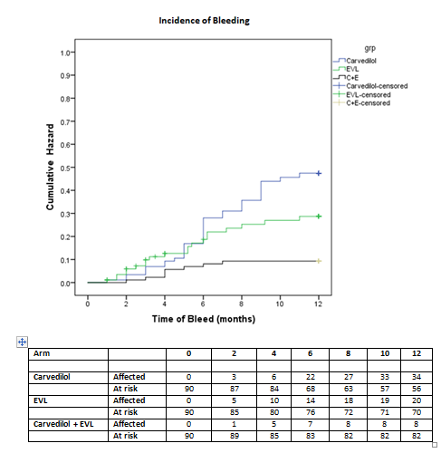
Eficacia de carvedilol, ligadura variceal endoscópica (LVE), o una combinación para prevención de primera hemorragia variceal en cirrosis Child B y C con riesgo alto de várices: Estudio controlado aleatorizado (NCT03069339).
Objetivo:
Evaluar la eficacia y seguridad de carvedilol o LVE sola o en combinación para prevenir primer episodio de hemorragia variceal en cirróticos avanzados con várices de alto riesgo.
Métodos:
Estudio prospectivo controlado aleatorizado.
270 cirróticos Child B y C con várices de alto riesgo [grandes(>5mm) (n=132; 48.9%) o pequeñas (<5mm, con signos significativos color rojo) (n=138;51.1%)] fueron aleatorizados prospectivamente (90 por grupo) para recibir carvedilol (Gr I) o LVE (Gr II) o combinación (Gr III). La edad media y score CTP en los tres grupos fue 50.98 ± 11.5; 50.93 ± 10.7; y 51.7 ±9.95 años (p=0.84); 8.9 ± 1.1; 9.18 ± 1.18; y 9.1 ± 1.19 (p=0.51).
Principales Hallazgos:
La probabilidad actuaria de una primera hemorragia durante una media de seguimiento de 10.42 (10-10.8) meses fue 37.8%; 22.2%; y 8.9% en los grupos I, II, y III respectivamente.
Conclusiones:
La combinación de carvedilol y LVE es más efectiva que cualquier terapia sola para prevención primaria de primer hemorragia variceal en várices de alto riesgo en cirrosis avanzada.
Incidence of Bleeding
Cumulative Hazard
Time of Bleed (Months)
Pande A, et al., Abstract 145
Notes:
145
EFFICACY OF CARVEDILOL, ENDOSCOPIC VARICEAL LIGATION (EVL) OR A COMBINATION FOR THE PREVENTION OF FIRST VARICEAL BLEED IN CHILD B AND C CIRRHOSIS WITH HIGH RISK VARICES: A RANDOMIZED CONTROLLED TRIAL (NCT03069339)
Dr. Apurva Pande^{1,2}, Prof. Shiv Kumar Sarin, MD, FAASLD³, Dr. Ankur Jindal³, Dr. Rajan V⁴ and Dr. Guresh Kumar Sr.⁵, (1)Institute of Liver and Biliary Sciences, New Delhi, India, (2)Hepatology, Institute of Liver and Biliary Sciences, (3)Hepatology, Institute of Liver and Biliary Sciences, New Delhi,India, (4)Hepatology, Ilbs, (5)Clinical Research, Institute of Liver and Biliary Sciences
Background:
Primary prophylaxis for esophageal varices in Child B and C cirrhosis is challenging as beta-blockers (BB) may be associated with higher side-effects and the incidence of post-EVL bleeding may be more in these patients. We evaluated the efficacy and safety of these therapies alone or in combination to prevent first variceal bleed in high risk varices. We also evaluated the adverse-effects related to the therapies.
Methods:
270 Child B and C cirrhotics with large (>5 mm) (n=132;48.9%) or small ‘high risk’(<5 mm, with significant red color signs) (n=138;51.1%) were prospectively enrolled (90 per group) to receive carvedilol (Gr I),EVL (Gr II) or both (Gr III). Hepatic venous pressure gradient (HVPG) was measured at baseline, 3 and 12 months. Primary end-point was first variceal bleed.The secondary end-points were bleed related mortality, improvement in CTP/MELD scores, incidence of secondary bacterial peritonitis (SBP); AKI; shock; new ascites along with HVPG response at 3 and 12 months and treatment related side-effects. Exclusion criteria included presence of HCC, portal vein thrombosis (PVT), Child A cirrhosis, CTP ≥13, contraindications to β blockers., platelet count < 30,000/mm^{3,} previous endoscopic variceal treatment, and presence of acute kidney injury (AKI).
Results:
Baseline characteristics of the three groups were comparable (Gr. I, II and III, age-50.98±11.5; 50.93±10.7 and 51.7±9.95 yr. (p=0.84), Males -76(32.6%); 78(33.5%) and 79(33.9%) (p=0.80), CTP score 8.9±1.1; 9.18±1.18 and 9.1±1.19 (p=0.51) and HVPG {15.9±3.3;16.8±4.03;17.4±3.7 mmHg} (p=0.31). Median dose of carvedilol in Gr.I and III was 15.6 mg (12.5-18.75) and 9.3mg (6.25-15.62) respectively (p<0.001). The actuarial probability of first bleeding during a mean follow-up of 10.42 (10-10.8) months was 37.8%; 22.2% and 8.9 % in groups I, II and III respectively (p <0.04, I vs II and <0.001 I vs III). Among the patients who had bled, the mortality rate was 18.2%;14.3% and 25% respectively (p=0.79). The incidence of new onset ascites {11.1%, 6.6% and 8.8%}, SBP {3.3%, 9% and 10%},shock {3.3%, 3.3%, 1.1%} and new onset AKI {1.1%,2.2% and 1.1%}were comparable (p=NS, each group). The incidence of post-EVL ulcer bleed in Gr. II and III were 6.7% and 3.3% respectively (p=0.05). Repeat HVPG showed response (≥20% reduction from baseline or ≤ 12 mmHg) in 21.11% (19) in Gr I, 16.67% (15) in Gr II and 33.3% (30) in Gr.III, (p value I vs II= NS, I vs III = 0.025). The MELD score increased from 16.43±2.13 at baseline to 18.4±1.6 at one year (p<0.001) in all three groups.
Conclusion:
Combination of carvedilol and EVL is more effective than either therapy alone in primary prevention of first variceal bleeding in Child B and C cirrhosis with high risk varices.
Disclosures:
The following people have nothing to disclose: Apurva Pande, Shiv Kumar Sarin, Ankur Jindal, Rajan V, Guresh Kumar

Slide 13
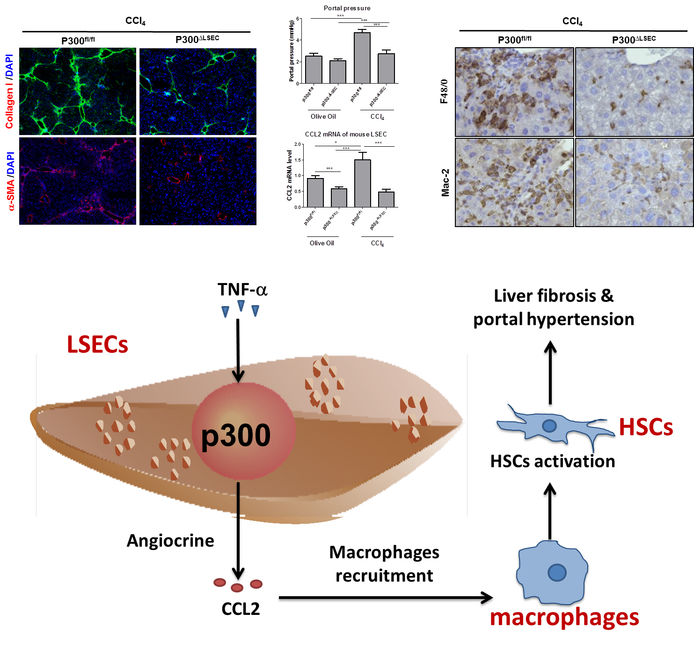
Deleción de P300 en las células endoteliales atenúa la hipertensión portal vía inhibición de señalización angiócrina mediante CCL-2
Objetivo:
Investigar el efecto de p300 específico para células endoteliales sinusoidales hepáticas (LSECs) en la regulación de señalización angiócrina e hipertensión portal.
Métodos:
In vivo, se indujo hipertensión portal por ligadura parcial de vena cava inferior (pIVCL) y fibrosis hepática por inyección de tetracloruro de carbono (CC4).
In vitro, LSECs humanas y LSECs primarias de ratón fueron aplicadas.
Principales Hallazgos:
La deleción de p300 de LSECs disminuye la fibrosis e hipertensión portal.
La deleción de p300 de LSECs inhibe la infiltración por macrófagos y activación de células estrelladas hepáticas (HSCs).
La inhibición de p300 regula a la baja el ligando de quimiocina 2 motif C-C (CCL2).
Conclusiones:
La deleción de p300 en las LSECs atenúa la activación de HSCs e infiltración por macrófagos vía señalización angiócrina dependiente de CCL2, fibrosis hepática e hipertensión portal.
Gao JH, et al., Abstract 242
Notes:
242
P300 DELETION IN LIVER ENDOTHELIAL CELL ATTENUATES PORTAL HYPERTENSION VIA INHIBITION OF CCL2-MEDIATED ANGIOCRINE SIGNALING
Dr. Jinhang Gao, Dr. Enis Kostallari, Dr. Mengfei Liu, Dr. Tejasav Sehrawat, Xiao Hu, Dr. Usman Yaqoob, Dr. Sheng Cao and Dr. Vijay Shah, MD, FAASLD, Division of Gastroenterology and Hepatology, Mayo Clinic, Rochester
Background:
Alteration of angiocrine signaling in chronic liver diseases can lead to macrophage recruitment, hepatic stellate cell (HSC) activation, liver fibrosis and portal hypertension. P300 is a cofactor for transcription factors, that is implicated in HSC fibrotic signaling pathways. However, the effect of liver sinusoidal endothelial cell (LSEC)-specific p300 on regulation of angiocrine signaling and portal hypertension is not explored and was the focus of this study.
Methods:
Mice with LSEC-specific p300 deletion were generated by crossing Cdh5^{CreERT2} with p300^{fl/fl} mice to obtain p300^{ΔLSEC}. In vivo, portal hypertension was induced by partial inferior vena cava ligation (pIVCL) and liver fibrosis by carbon tetrachloride (CCl₄) injection. Primary human LSEC were pre-treated with p300 inhibitor CBP30 and then co-cultured with human HSC on a transwell system.
Results:
In response to pIVCL, the increase in portal pressure and HSC activation were attenuated in p300^{ΔLSEC} mice compared to littermate p300^{fl/fl} control mice (n=6, p<0.05). In CCl₄ mouse model, portal pressure and liver fibrosis were ameliorated in p300^{ΔLSEC} mice compared to littermate p300^{fl/fl} control mice (n=6, p<0.05). In CCl₄ mouse model, HSC activation marker (aSMA), total macrophage markers (CD68, F4/80 and Mac2) and infiltrated macrophage makers (CCR2, Ly6c and S100A9) were also attenuated in p300^{ΔLSEC} mice compared to littermate p300^{fl/fl} control mice (n=6, p<0.05). Targeted PCR analysis of 25 inflammatory, vascular, and fibrogenic gene transcripts revealed that C-C motif chemokine ligand 2 (CCL2) mRNA level was significantly increased in CCl₄-induced fibrotic liver and in LSEC isolated from fibrotic liver and this increase was attenuated in p300^{ΔLSEC} mice (n=6, p<0.05). Among primary liver cell types, LSEC presented the highest CCL2 expression (n=3, p<0.05). In primary mouse LSEC, p300 genetic deletion leads to 5 fold decrease of CCL2 expression (n=3, p<0.05). In primary human LSEC, p300 inhibition by CBP30 treatment decreased CCL2 expression and reduced HSC activation in an LSEC-HSC co-culture assay (n=3, p<0.05).
Conclusion:
Our results suggest that p300 deletion in LSEC attenuates HSC activation and macrophage infiltration via CCL2-dependent angiocrine signaling, liver fibrosis and portal hypertension.
Disclosures:
Vijay Shah – Enterome: Advisory Committee or Review Panel; Novartis Pharmaceuticals: Advisory Committee or Review Panel; Vital Therapies, Inc.: Advisory Committee or Review Panel; Afimmune, Ltd.: Advisory Committee or Review Panel; Durect Coporation: Advisory Committee or Review Panel
The following people have nothing to disclose: Jinhang Gao, Enis Kostallari, Mengfei Liu, Tejasav Sehrawat, Xiao Hu, Usman Yaqoob, Sheng Cao

Slide 14
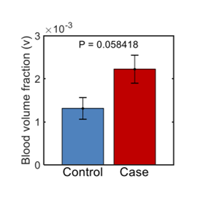
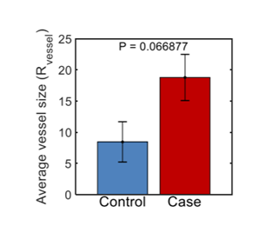
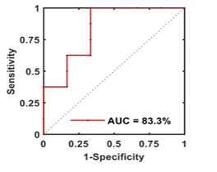
Marcadores de espectroscopía de la microcirculación de la mucosa intestinal para diagnóstico de cirrosis
Hipótesis/Objetivo:
La cuantificación rigurosa del flujo sanguíneo de la mucosa intestinal, el cual esta incrementado en hipertensión portal, puede servir como marcador subrogado de presión portal.
Determinar la factibilidad y habilidad de una sonda EGD que contiene microscopía polarizada cerrada novel, para cuantificar microcirculación de mucosa intestinal y detectar cirrosis.
Métodos:
Se obtuvieron mediciones por espectroscopía microvascular (10 lecturas)-fracción de volumen sanguíneo promedio (v), fracción promedio de deoxy-hemoglobina, y radio promedio de vaso sanguíneo (R_{vessel}) a profundidad superficial (<100 µm), intermedia 100-200 µm), y profunda (200-300 µm) en diferentes localizaciones del intestino superior en 7 pacientes cirróticos y 7 no cirróticos, durante endoscopía de cuidado estandarizado.
Conclusiones:
La cuantificación por espectroscopía de la mucosa superficial duodenal es un subrogado prometedor de presión portal y puede diferenciar sujetos con cirrosis de aquellos sin cirrosis.
2 (a)
2 (b)
Figure 2(a) Duodenal blood volume fraction (v) and Figure 2(b) average vessel radius (R_{vessel}) in superficial mucosal layer is increased in cirrhotics (case) as compared to non-cirrhotics (controls)
Figure 3: Performance of a combined biomarker
Sensitivity: 100%
Specificity: 66.67%
Mohanty A, et al., Abstract 243
Notes:
243
CAN SPECTROSCOPIC MARKERS OF GUT MUCOSAL MICRO-CIRCULATION SERVE AS A SURROGATE FOR PORTAL HYPERTENSION AND DIAGNOSE CIRRHOSIS?
Dr. Arpan Mohanty¹, Phanisyam Kamineni¹, Adam Eshein², Dr. Vadim Backman² and Dr. Hemant Roy¹, (1)Section of Gastroenterology, Boston Medical Center, (2)Biomedical Engineering Department, Northwestern University
Background:
Portal hypertension is characterized by increase in blood flow to the gut mucosa leading to dilated capillaries and veins in the mucosa and submucosa visually discernable as gastropathy or duodenopathy. We hypothesize that the rigorous quantification of gut mucosal blood flow could serve as a surrogate for portal pressure and thus differentiate patients with cirrhosis (portal pressure ≥ 5 mm Hg) from those without (portal pressure < 5 mm Hg). The aim was to determine the feasibility and efficacy of an esophagogastroduodenoscopy (EGD) scope compatible probe containing novel polarization gated spectroscopy in quantifying gut mucosal microcirculation and detecting cirrhosis
Methods:
Adult (age>18 years) patients with cirrhosis undergoing EGD for variceal screening (n=7; cases) and non-cirrhotic patients undergoing standard of care EGD for causes other than variceal screening (n=7, controls) were recruited. Cases and controls underwent transient elastography to confirm presence or absence of cirrhosis. Patients with history of prior variceal banding, occlusive portal vein thrombosis, surgical interventions to portal circulation such as transjugular intrahepatic portosystemic shunt were excluded. Spectroscopic microvascular measurements such as average blood volume fraction, average fraction of unsaturated blood (deoxy hemoglobin) and average blood vessel radius were obtained at superficial <100µm intermediate(100-200 µm and deep ( 200-300 µm) depths of the distal esophagus, antrum, fundus and duodenal bulb during standard-of-care EGD. 10 readings were obtained at each anatomic site.
Results: The blood volume fraction (v)and the blood vessel radius (r) in the superficial duodenal mucosa were the most promising spectroscopic markers of cirrhosis. A combination of the two markers had 100% sensitivity and 66% specificity in diagnosis of cirrhosis.
Conclusion: Spectroscopic quantification of duodenal mucosa is a promising surrogate of portal pressure and can differentiate subjects with cirrhosis from those without. Studies are underway to determine the utility of these markers in diagnosis of varices (marker of clinically significant portal hypertension) and as a surrogate for hepatic venous portal gradient.
Disclosures:
The following people have nothing to disclose: Arpan Mohanty, Arpan Mohanty
Disclosure information not available at the time of publication: Phanisyam Kamineni, Adam Eshein, Vadim Backman, Hemant Roy

Slide 15
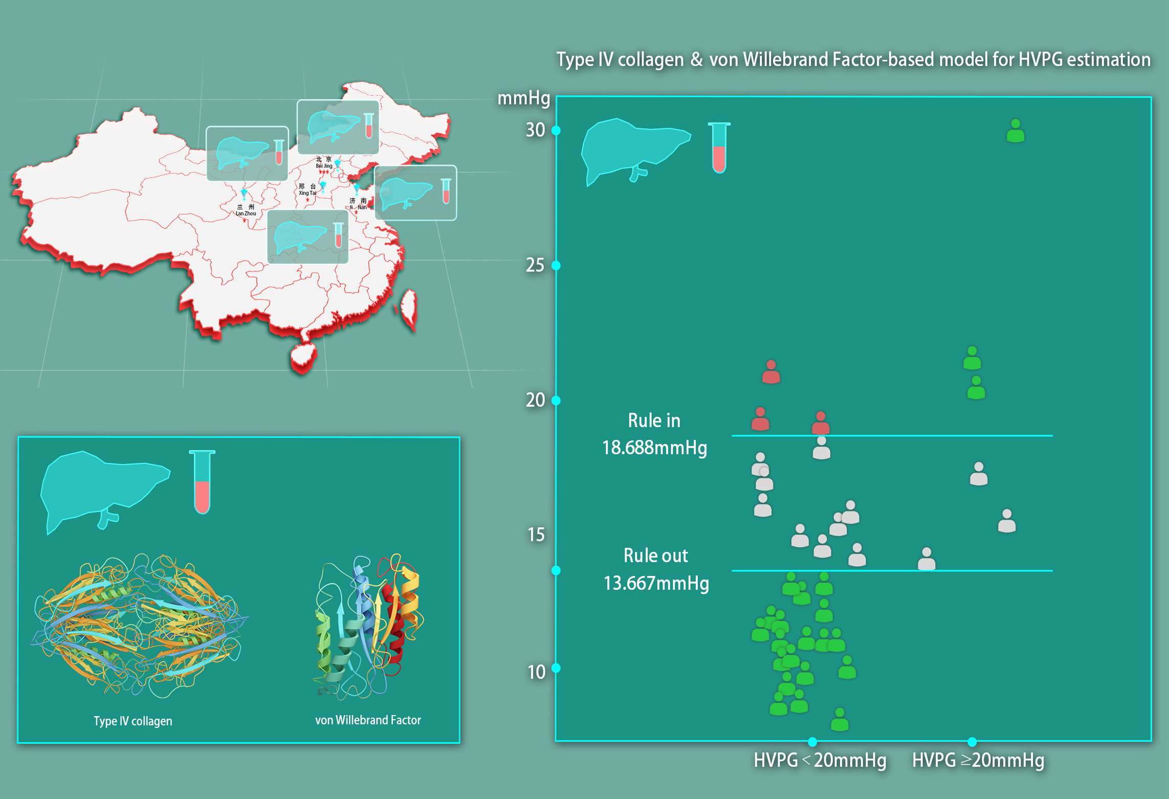
Colágena tipo IV como biomarcador no invasivo para predecir falla para controlar sangrado y resangrado temprano en cirrosis (CHESS1902): Estudio prospectivo, multicéntrico.
Objetivo:
Desarrollar un modelo no invasivo para predicción de gradiente de presión venosa hepática (HVPG) mayor a 20 mmHg o no basado en biomarcadores séricos involucrados en el proceso fisiopatológico de enfermedad hepática crónica avanzada.
Métodos:
Setenta y siete participantes con cirrosis fueron prospectivamente reclutados de 4 centros en China. Muestras sanguíneas fueron tomadas y el HVPG fue medido para evaluar la correlación entre biomarcadores séricos y HVPG. El rango de valores para confirmar o descartar HVPG ≥20 mmHg fue calculado usando los mejores biomarcadores correlacionados para la totalidad de la cohorte y la cohorte asociada a VHB.
Conclusiones:
La colágena tipo IV es un potencial biomarcador para descartar pacientes cirróticos con HVPG ≥20 mmHg, mientras que la Colágena tipo IV combinada con factor de von Willebrand tiene un desempeño satisfactorio en cirrosis relacionada a VHB.
Shao RY, et al., Abstract 246
Notes:
246
TYPE IV COLLAGEN AS NOVEL NONINVASIVE BIOMARKER TO PREDICT FAILURE TO CONTROL BLEEDING AND EARLY REBLEEDING IN PATIENTS WITH CIRRHOSIS: A PROSPECTIVE, MULTICENTER STUDY
Ruoyang Shao^{1,2}, Xiangbo Zeng^{1,2}, Dr. Chuan Liu^{1,2}, Chunqing Zhang³, Yu Wang⁴, Ruizhao Qi⁵, Xinlong Lin², Yue Zhang⁶, Jitao Wang⁷, Dengxiang Liu⁷, Dr. Jiming Yin⁸, Dr. Yanna Liu Jr.^{1,2}, Fuquan Liu⁹ and Dr. Xiaolong Qi¹, (1)CHESS Center, the First Hospital of Lanzhou University, (2)Department of Hepatology Unit and Infectious Diseases, Nanfang Hospital, Southern Medical University, (3)Department of Gastroenterology, Shandong Provincial Hospital, Shandong University, (4)Liver Research Center, Beijing Friendship Hospital, Capital Medical University, (5)Department of General Surgery, the Fifth Medical Center of General PLA Hospital, (6)Peking University Ninth School of Clinical Medicine, Beijing Shijitan Hospital, (7)CHESS Working Party, Xingtai People’s Hospital, (8)Capital Medical University Affiliated Beijing You an Hospital, Beijing Institute of Hepatology, (9)Department of Interventional Therapy, Beijing Shijitan Hospital, Capital Medical University
Background:
Esophagogastric variceal bleeding is a lethal complication in cirrhotic patients with portal hypertension. A hepatic venous pressure gradient (HVPG) higher than 20 mmHg has been demonstrated to be a strong predictor for failure to control bleeding and early rebleeding. In this study, we aim to develop a non-invasive model for prediction of HVPG higher than 20 mmHg based on serum biomarkers involved in the pathophysiological process of advanced chronic liver disease.
Methods:
In this prospective multicenter study (ClinicalTrials.gov ID: NCT03713606), seventy-seven participants with cirrhosis were prospectively recruited from 4 centers in China between September 2018 and January 2019. All participants received HVPG measurement upon enrollment and blood samples were taken for measurement of serum level of 6 proteins including type IV collagen (C.IV), Hyaluronidase, procollagen type III, laminin, von Willebrand factor (vWF) and vascular cell adhesion molecule 1. The biomarkers included in the diagnostic model were selected complying to Akaike Information Criterion (AIC) in the total cohort and hepatitis B virus (HBV) sub-cohort, respectively. The predictive performance of the models was evaluated by the area under the receiver operating characteristic curve (AUC) taking HVPG threshold as 20 mmHg. Two values achieving a specificity or sensitivity higher than 90% were taken as rule in and rule out cut-off values and positive predictive value and negative predictive value (NPV) were calculated. This study was approved by all the local institutional review boards with written informed consents obtained from the participants.
Results:
Serum level of 6 biomarkers was obtained in 74 out of 77 participants. In the total cohort (n=74), C.IV alone manifested the best correlation with HVPG (r=0.542, P<0.001). AUC calculated and internal validated by Jackknife method was 0.762 (0.619-0.905). Rule out cut-off value of HVPG estimated with this model was 14.781 mmHg with an NPV of 97.4%. In the HBV sub-cohort (n=39), the combination of C.IV and vWF was the best performing model (r=0.691, P<0.001) with an AUC of 0.823 (0.660-0.986). The rule out cut-off value was 14.781 mmHg with an NPV of 100.0%.
Conclusion:
C.IV is a potential biomarker for ruling out cirrhotic patients with high risk of failure to control bleeding and early rebleeding while combination of C.IV and vWF has a satisfying performance in patients with HBV-related cirrhosis.
Disclosures:
The following people have nothing to disclose: Ruoyang Shao, Xiangbo Zeng, Chuan Liu, Chunqing Zhang, Yu Wang, Ruizhao Qi, Xinlong Lin, Yue Zhang, Jitao Wang, Dengxiang Liu, Jiming Yin, Yanna Liu, Fuquan Liu, Xiaolong Qi

Slide 16
Hipertensión Portal / Cirrosis

